Slide 1
Feature & target correlation
Timo Sommer

Slide 2
Diabetes dataset
target | age | sex | bmi | bp | s1 | s2 | s3 | s4 | s5 | s6
151 | 59 | 2 | 32.1 | 101 | 157 | 93.2 | 38 | 4 | 4.86 | 87
75 | 48 | 1 | 21.6 | 87 | 183 | 103.2 | 70 | 3 | 3.89 | 69
141 | 72 | 2 | 30.5 | 93 | 156 | 93.6 | 41 | 4 | 4.67 | 85
206 | 24 | 1 | 25.3 | 84 | 198 | 131.4 | 40 | 5 | 4.89 | 89
135 | 50 | 1 | 23.0 | 101 | 192 | 125.4 | 52 | 4 | 4.29 | 80
…

Slide 3
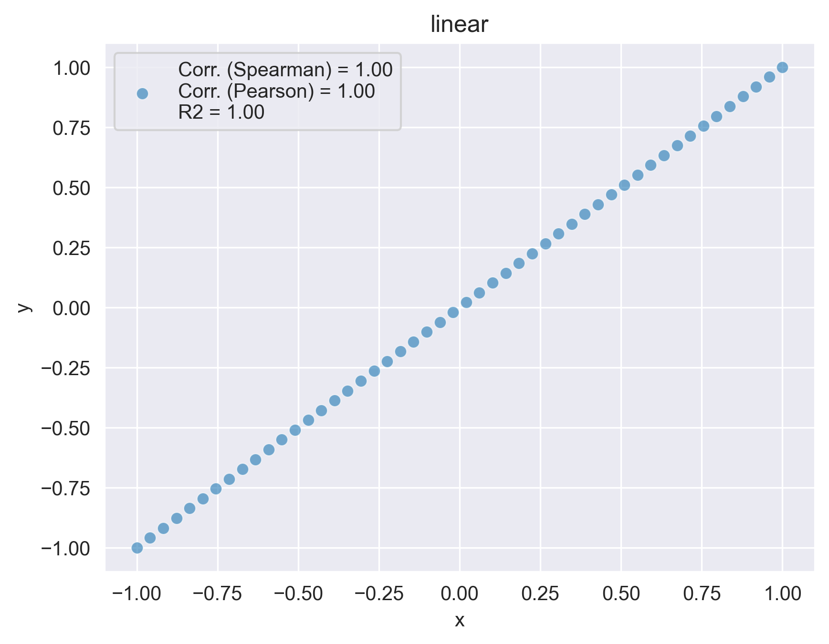
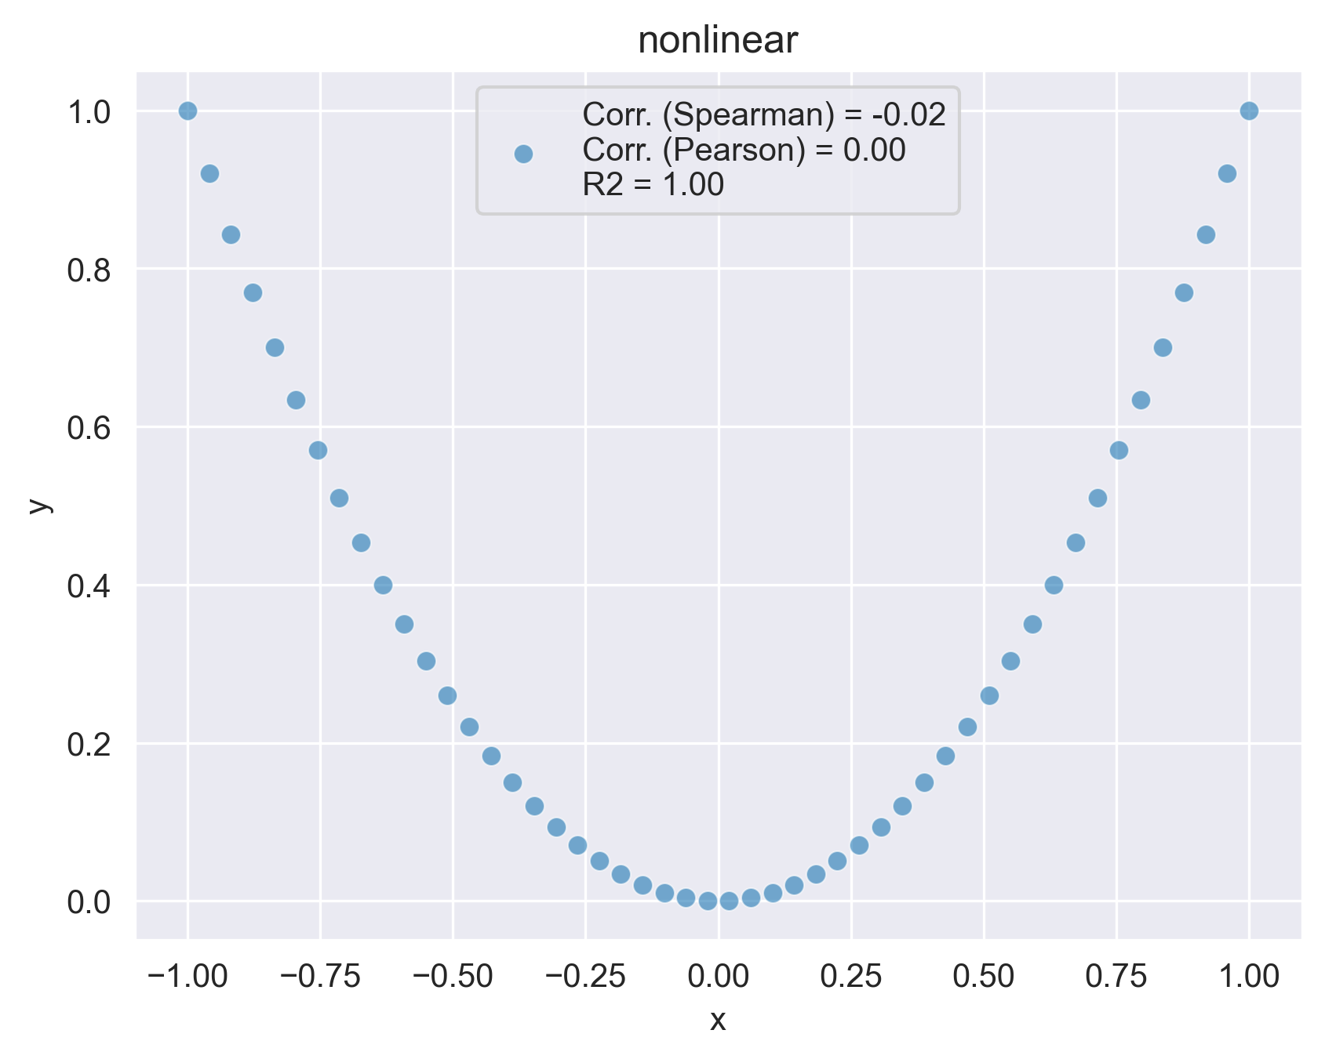

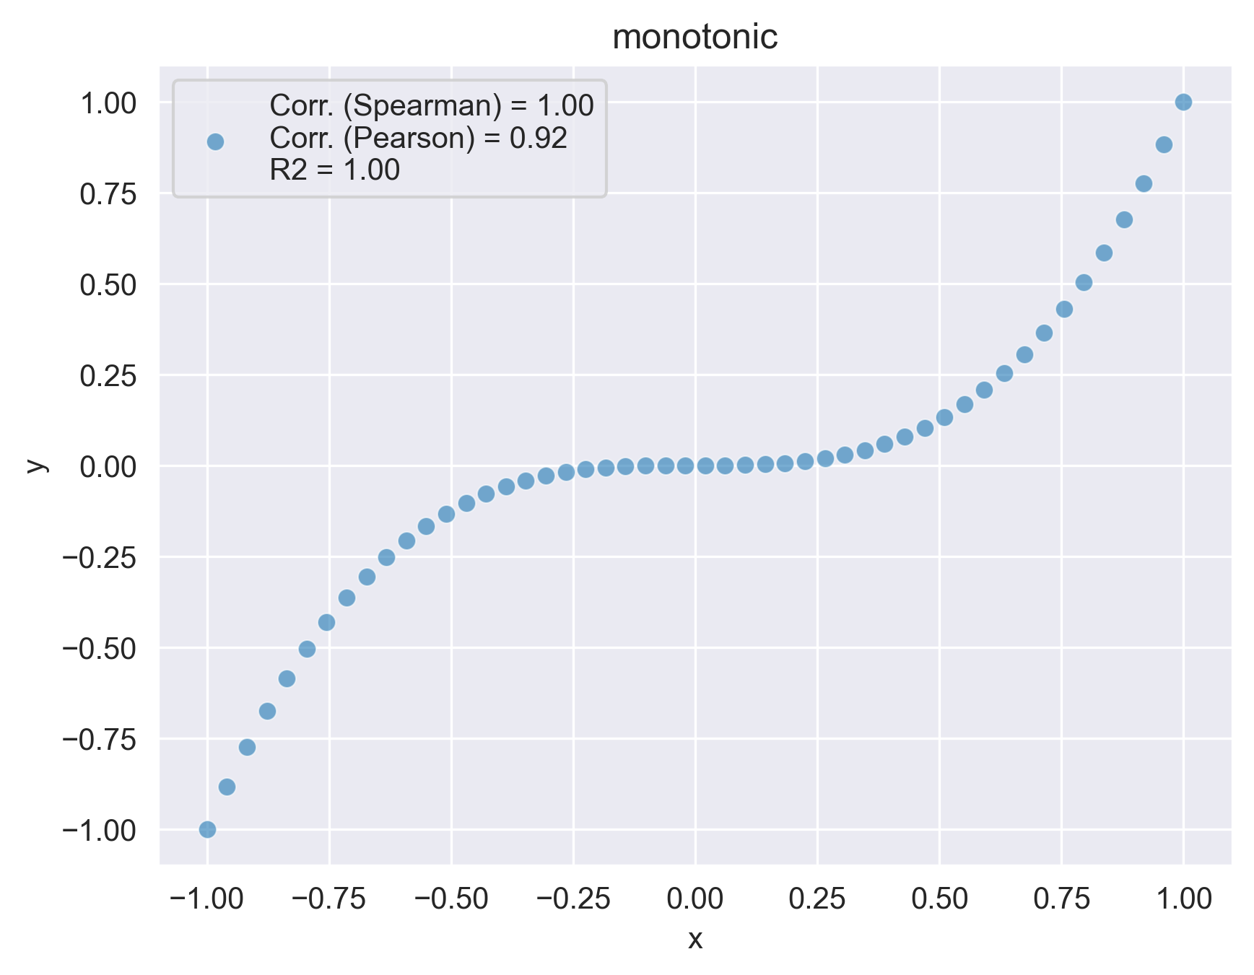
Types of correlation

Slide 4
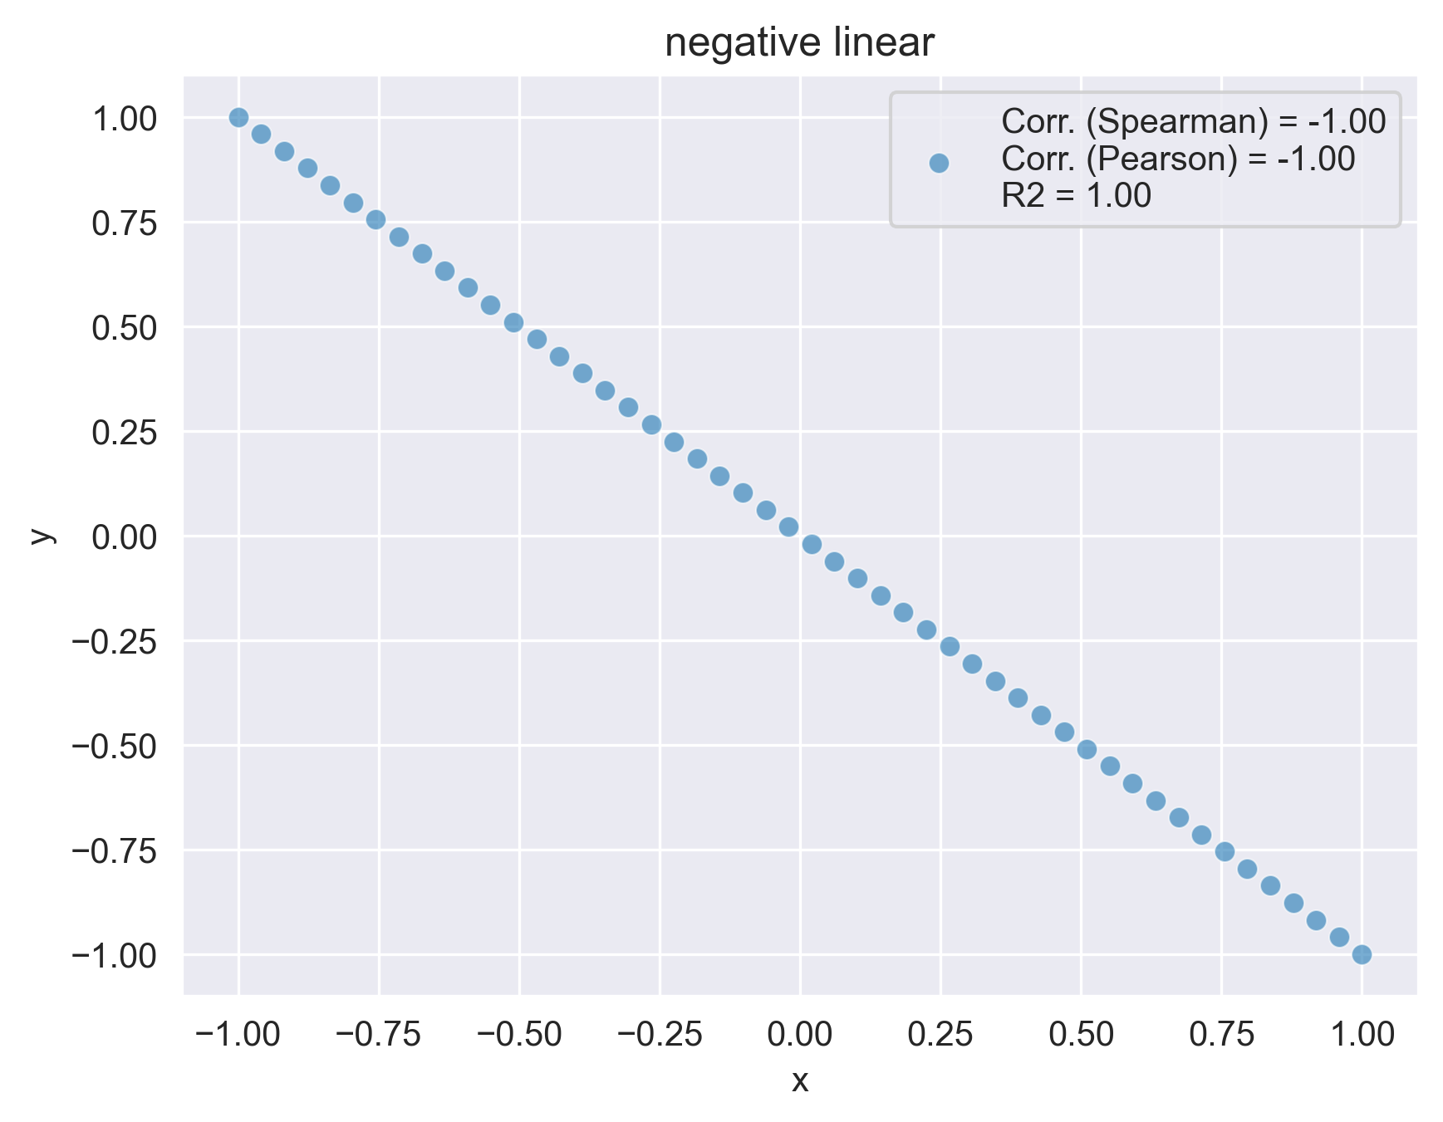
Types of correlation
 | Pearson | Spearman
linear | 1.0 | 1.0
nonlinear | 0.0 | 0.0
neg. linear | -1.0 | -1.0
monotonic | 0.92 | 1.0

Slide 5
Which features are most correlated with the target?
 | Advantages | Disadvantages | Multi-collinearity | Feature interactions | Correlation Type
Pearson | Easy to interpret | Sensitive to outliers and multi-collinearity | - | - | linear
Linear Regression | Same | Same | - | -
Lasso Regression | Focusses on most important features | Arbitrarily chooses 1 feature for multi-collinear features | Goodish | -
PCA | Handles MC | Not much interpretability | Good | -
Spearman | Simple and catching some non-linearities | Sensitive to outliers and multi-collinearity | - | - | monotonic
Permutation Invariance | Good allrounder. Model-dependent | More costly, statistical noise | Very good | Good | Non-linear
Random Forest | Good allrounder | Hard to interpret, biased towards high-cardinality features | Good | Good

Slide 6
Diabetes dataset: feature/target correlation
 | Random Forest | Permutation Invariance | Spearman | Pearson | PCA | Lin. Reg. | Lasso
bmi | 0.3 | 0.5 | 0.6 | 0.6 | 0.3 | 0.2 | 0.4
s5 | 0.3 | 0.4 | 0.6 | 0.6 | 0.4 | 0.2 | 0.4
bp | 0.1 | 0.2 | 0.4 | 0.4 | 0.3 | 0.1 | 0.1
s6 | 0.1 | 0.1 | 0.4 | 0.4 | 0.3 | 0.0 | 0.0
age | 0.1 | 0.1 | 0.2 | 0.2 | 0.2 | 0.0 | 0.0
s2 | 0.1 | 0.1 | 0.2 | 0.2 | 0.4 | 0.1 | 0.0
s3 | 0.1 | 0.1 | -0.4 | -0.4 | -0.3 | 0.0 | -0.1
s1 | 0.1 | 0.1 | 0.2 | 0.2 | 0.3 | -0.2 | 0.0
s4 | 0.0 | 0.0 | 0.5 | 0.4 | 0.4 | 0.1 | 0.0
sex | 0.0 | 0.0 | 0.0 | 0.0 | 0.2 | -0.1 | 0.0

Slide 7
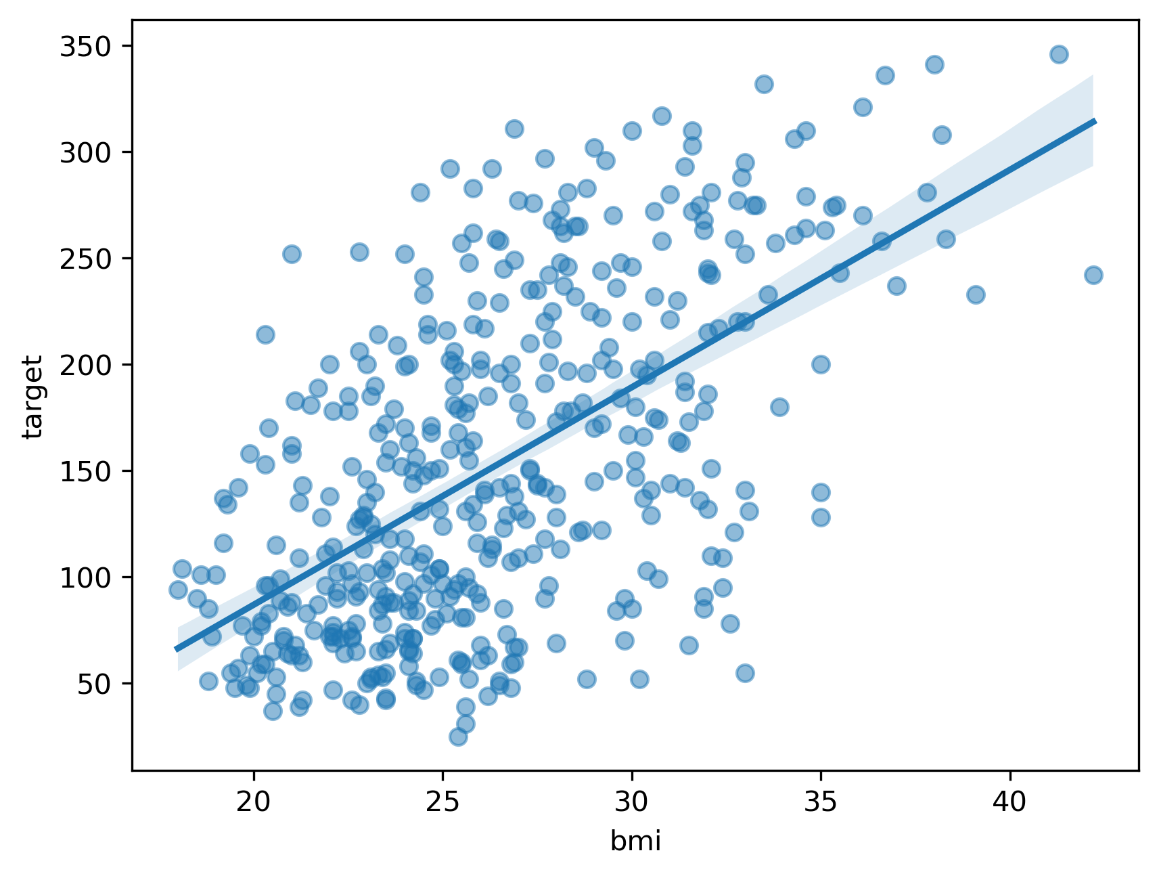
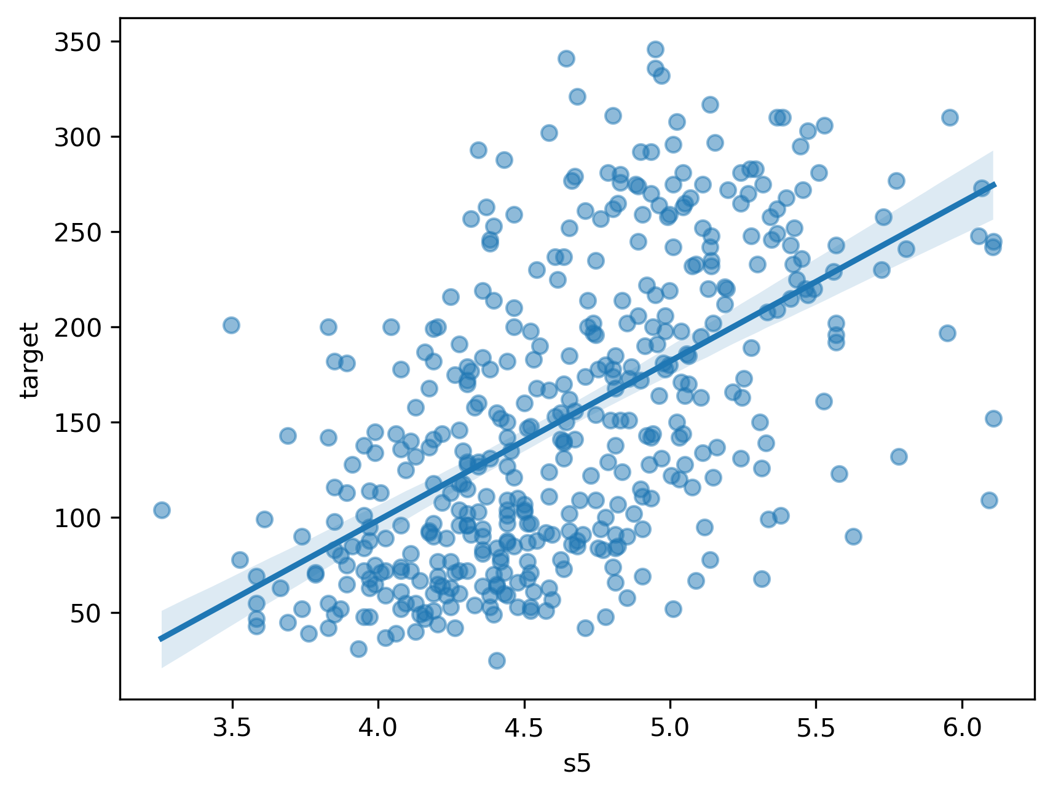
Scatter plots to check correlation
Much more sophisticated methods: SHAP, LIME, ELI5, ...

